Slide 1

Algebra 1
Unit 3, Lesson 7 Interpreting Linear Models Volume 1, pg. 144

Slide 2


Benchmark
MA.912.DP.2.4
Fit a linear function to bivariate numerical data that suggests a linear association and interpret the slope and 𝑦-intercept of the model. Use the model to solve real-world problems in terms of the context of the data.
volume 1, pg. 144

Slide 3
Integrated Mathematical Thinking and Reasoning Standards
MA.K12.MTR.4.1 Engage in discussions that reflect on the mathematical thinking of self and others.
MA.K12.MTR.6.1 Assess the reasonableness of solutions.
MA.K12.MTR.7.1 Apply mathematics to real-world contexts.
volume 1, pg. 144

Slide 4

Learning Targets
I can interpret the correlation coefficient, slope, and 𝑦-intercept of a linear equation fit to real-world data.
I can use the linear equation fit to bivariate data to solve real-world problems in terms of the context of the data.
volume 1, pg. 144

Slide 5

Warm-Up
volume 1, pg. 144

Slide 6
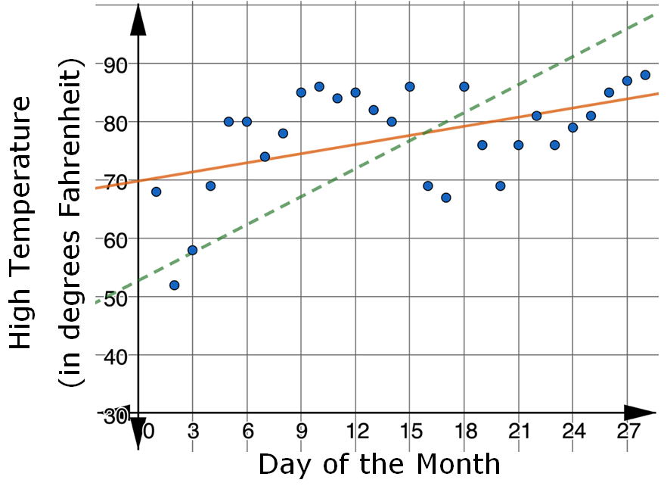
3.7.1 Warm-Up: Bell Work
The scatter plot shows the relationship between the day of the month and the high temperature, in degrees Fahrenheit, for February 2021 in Brooksville, FL.
volume 1, pg. 144
Notes:
Video Link: https://algebranation.wistia.com/medias/fi4fidi5y8

Slide 7
Which line fits the data better, the solid orange line or the dashed green line?
Explain your reasoning.
Use inequalities to represent an appropriate domain and range for the data represented.
Domain
Range
volume 1, pg. 144
Notes:
Video Link: https://algebranation.wistia.com/medias/fi4fidi5y8

Slide 8

Activity
volume 1, pg. 145

Slide 9
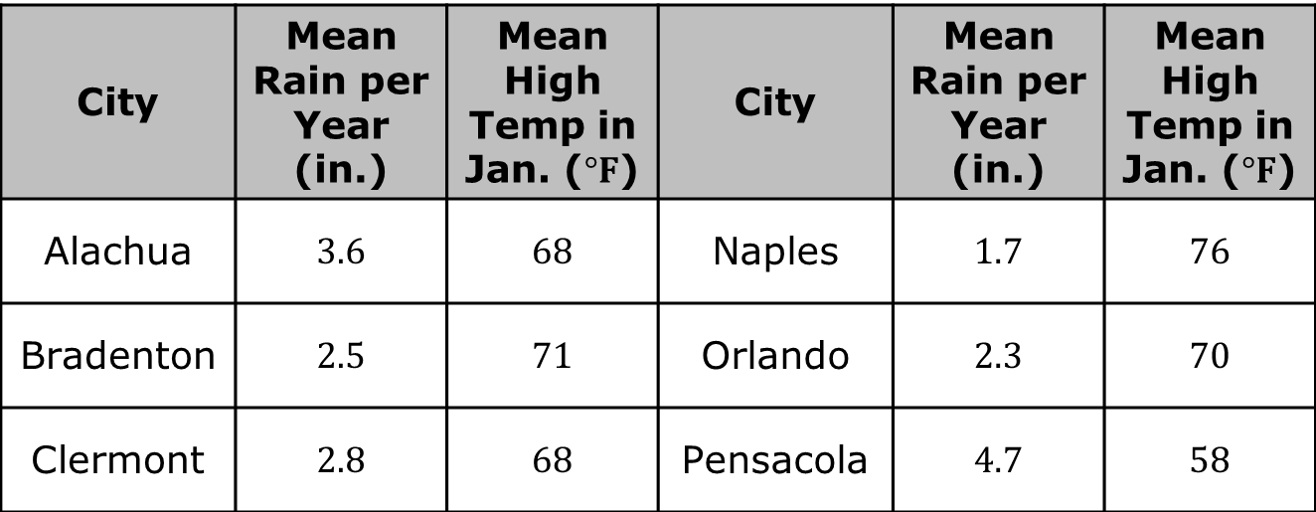
3.7.2 Activity: Station 1: High Temperature and Rainfall
The table shows the mean high temperature in January, in degrees Fahrenheit (℉), and the mean amount of rainfall per year, in inches (in.), for $20$ cities in Florida.
City | Mean Rain per Year (in.) | Mean High Temp in Jan. ($°F$) | City | Mean Rain per Year (in.) | Mean High Temp in Jan. ($°F$)
Alachua | 3.6 | 68 | Naples | 1.7 | 76
Bradenton | 2.5 | 71 | Orlando | 2.3 | 70
Clermont | 2.8 | 68 | Pensacola | 4.7 | 58
volume 1, pg. 145

Slide 10
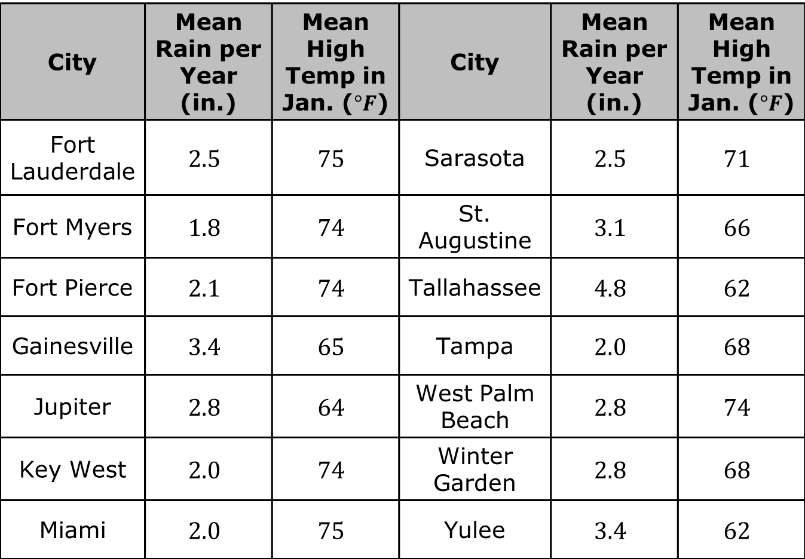
City | Mean Rain per Year (in.) | Mean High Temp in Jan. ($°F$) | City | Mean Rain per Year (in.) | Mean High Temp in Jan. ($°F$)
Fort Lauderdale | $$2.5$$ | $$75$$ | Sarasota | $$2.5$$ | $$71$$
Fort Myers | $$1.8$$ | $$74$$ | St. Augustine | $$3.1$$ | $$66$$
Fort Pierce | $$2.1$$ | $$74$$ | Tallahassee | $$4.8$$ | $$62$$
Gainesville | $$3.4$$ | $$65$$ | Tampa | $$2.0$$ | $$68$$
Jupiter | $$2.8$$ | $$64$$ | West Palm Beach | $$2.8$$ | $$74$$
Key West | $$2.0$$ | $$74$$ | Winter Garden | $$2.8$$ | $$68$$
Miami | $$2.0$$ | $$75$$ | Yulee | $$3.4$$ | $$62$$
volume 1, pg. 145

Slide 11
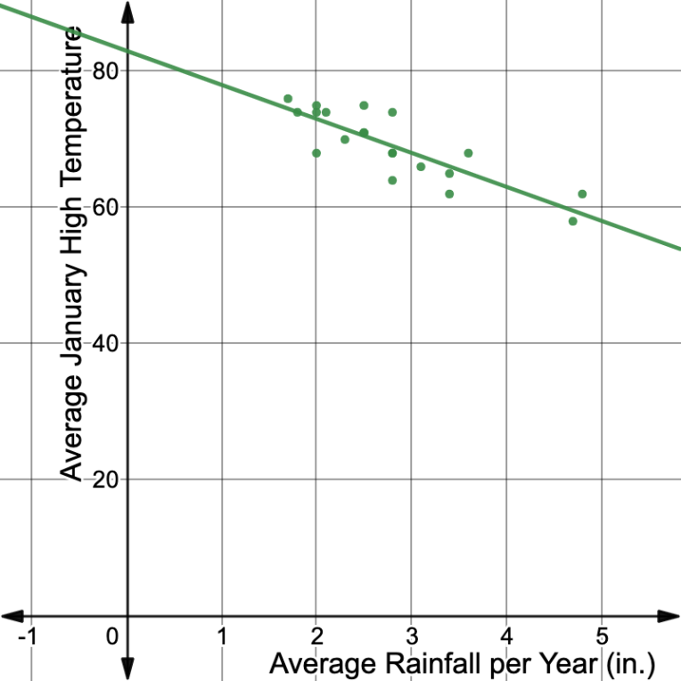
The scatter plot shown represents the data from the table with a linear equation fit to model the relationship.
volume 1, pg. 145

Slide 12
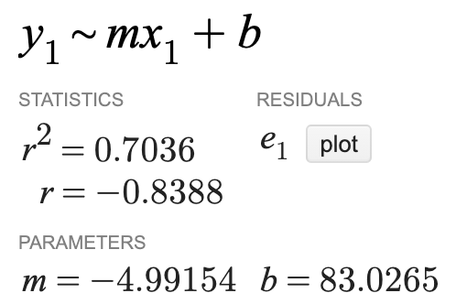
The screenshot shows the slope, 𝑦-intercept, and correlation coefficient associated with the linear relationship modeled on the scatter plot.
Write the equation of the line of best fit shown.
volume 1, pg. 145

Slide 13
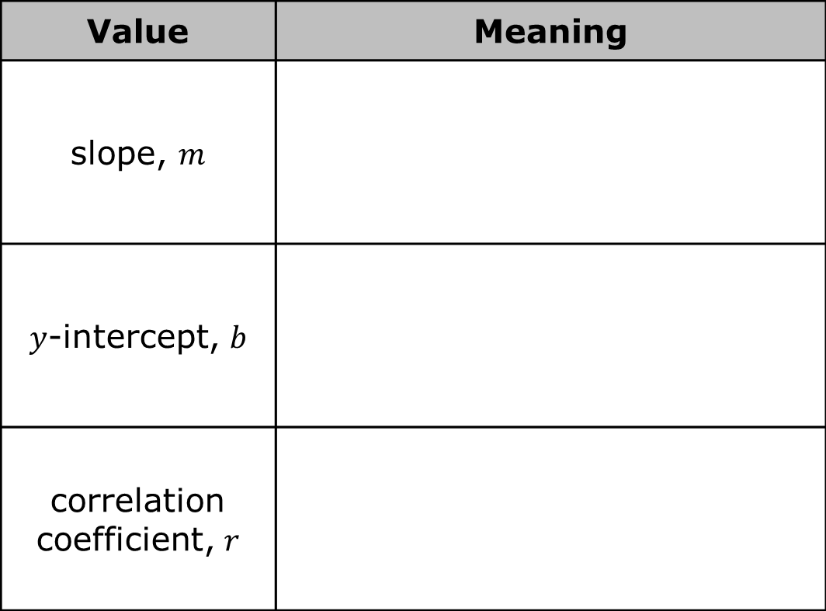
Interpret the meaning of each value listed in the table.
Value | Meaning
slope, $m$
$y$-intercept, $b$
correlation coefficient, $r$
volume 1, pg. 146

Slide 14

Use inequalities to express an appropriate domain and range using the linear equation that models the data.
Use the model to predict the mean high temperature in January for a Florida city that has a mean of $4.0$ inches of rainfall per year.
Domain
Range
volume 1, pg. 146

Slide 15
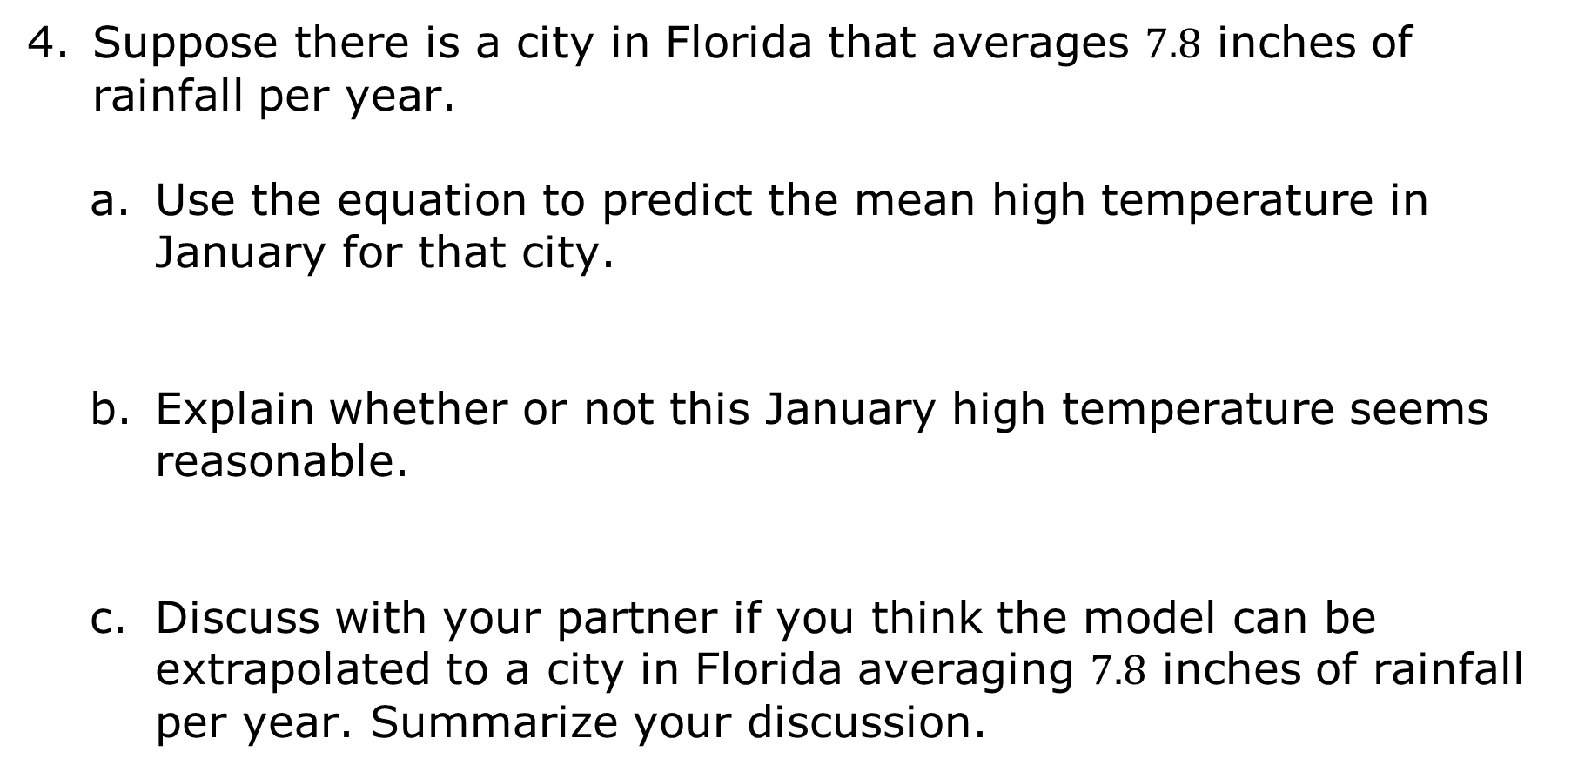
Suppose there is a city in Florida that averages $7.8$ inches of rainfall per year.
Use the equation to predict the mean high temperature in January for that city.
Explain whether or not this January high temperature seems reasonable.
Discuss with your partner if you think the model can be extrapolated to a city in Florida averaging $7.8$ inches of rainfall per year. Summarize your discussion.
volume 1, pg. 146

Slide 16
Activity
volume 1, pg. 147

Slide 17
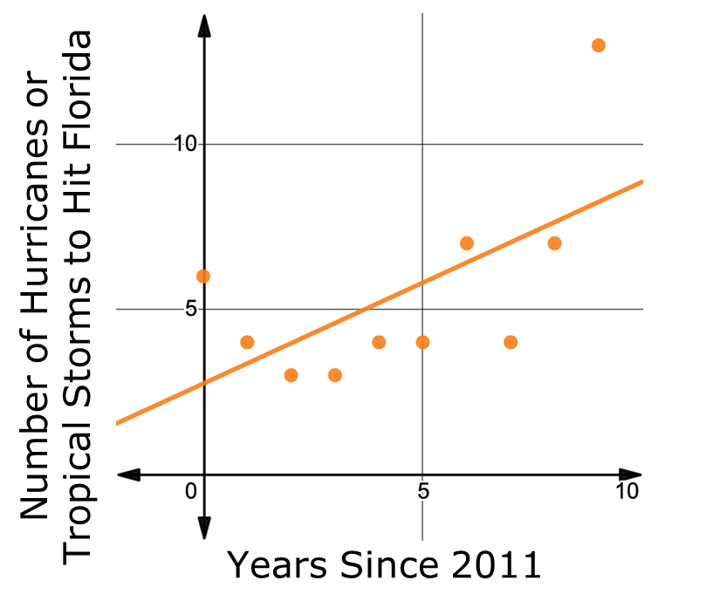
3.7.3 Activity: Station 2: Hurricanes in Florida Since 2011
Michaela wondered if there was a trend between the number of hurricanes and tropical storms that hit Florida and time. She used data for the number of hurricanes and tropical storms to hit Florida from 2011-2020 to create the scatter plot shown.
volume 1, pg. 147

Slide 18

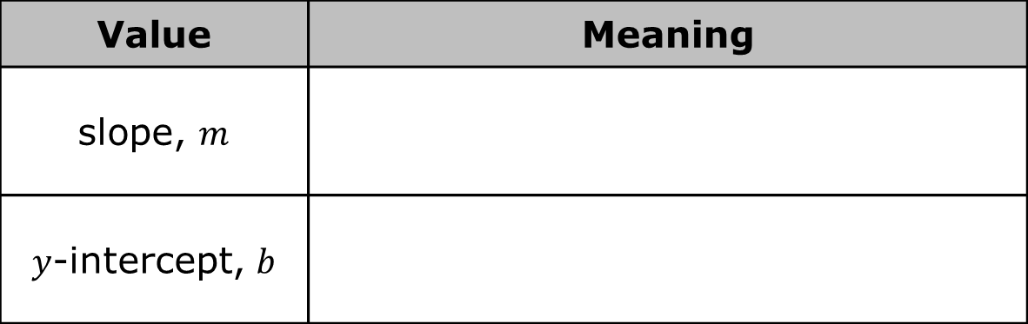
The equation $y=0.612x+2.75$ models this relationship.
Interpret the meaning of the slope and 𝑦-intercept in context.
Explain why it does not make sense for the slope or 𝑦-intercept to be decimal values in this context.
Value | Meaning
slope, $m$
$y$-intercept, $b$
volume 1, pg. 147

Slide 19
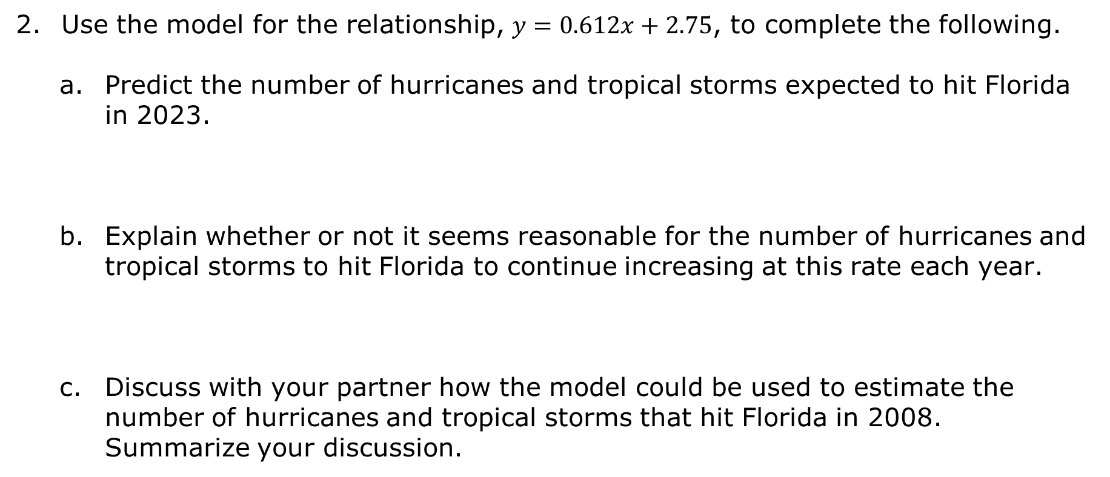
Use the model for the relationship, $y=0.612x+2.75$, to complete the following.
Predict the number of hurricanes and tropical storms expected to hit Florida in 2023.
Explain whether or not it seems reasonable for the number of hurricanes and tropical storms to hit Florida to continue increasing at this rate each year.
Discuss with your partner how the model could be used to estimate the number of hurricanes and tropical storms that hit Florida in 2008. Summarize your discussion.
volume 1, pg. 147

Slide 20
Activity
volume 1, pg. 148

Slide 21
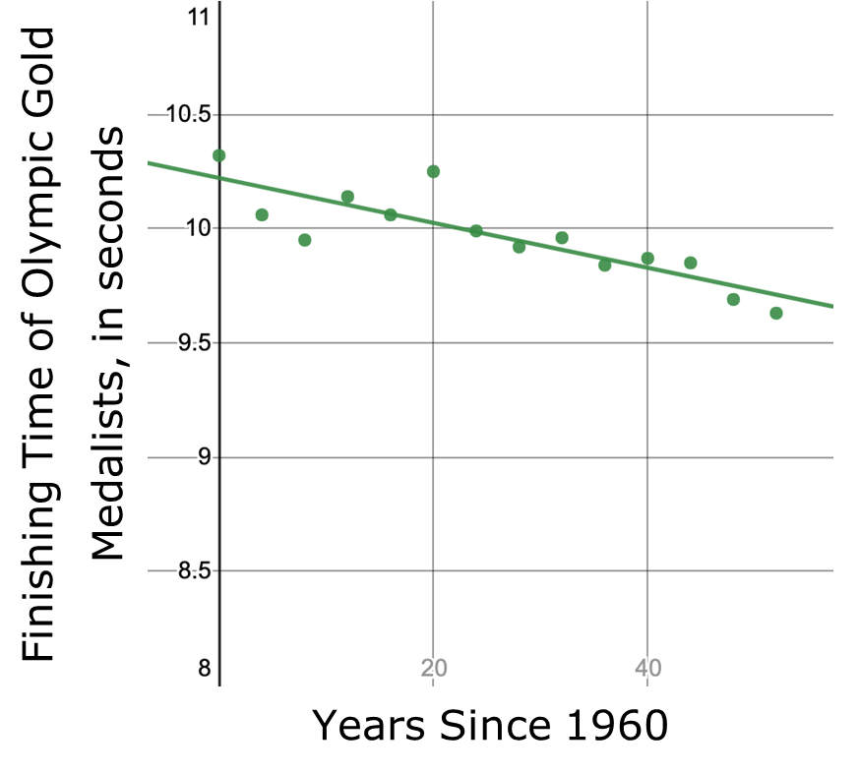
3.7.4 Collaboration: Station 3: Men’s 100-Meter Dash at the Olympics
The scatter plot shows the finishing times for the Olympic gold medalist in the men's 100-meter (m.) dash for the Olympic games since 1960.
Dana says that the strength and direction of the linear association between the two variables is moderately negative. Explain whether or not you agree with Dana.
volume 1, pg. 148

Slide 22
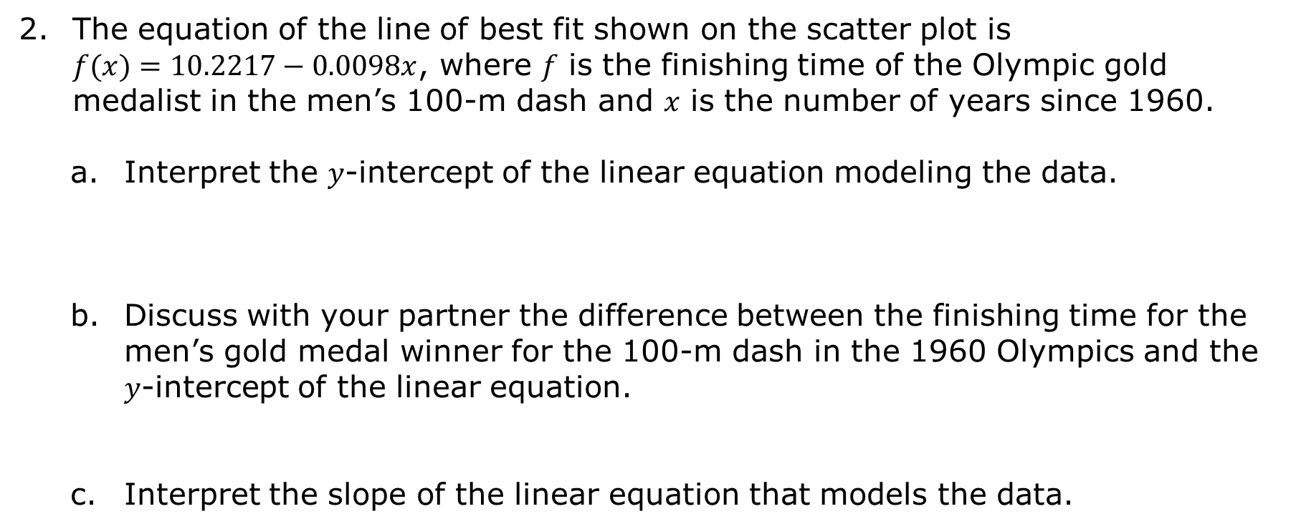
The equation of the line of best fit shown on the scatter plot is $f(x)=10.2217−0.0098x$, where 𝑓 is the finishing time of the Olympic gold medalist in the men’s 100-m dash and 𝑥 is the number of years since 1960.
Interpret the 𝑦-intercept of the linear equation modeling the data.
Discuss with your partner the difference between the finishing time for the men’s gold medal winner for the 100-m dash in the 1960 Olympics and the 𝑦-intercept of the linear equation.
Interpret the slope of the linear equation that models the data.
volume 1, pg. 148

Slide 23
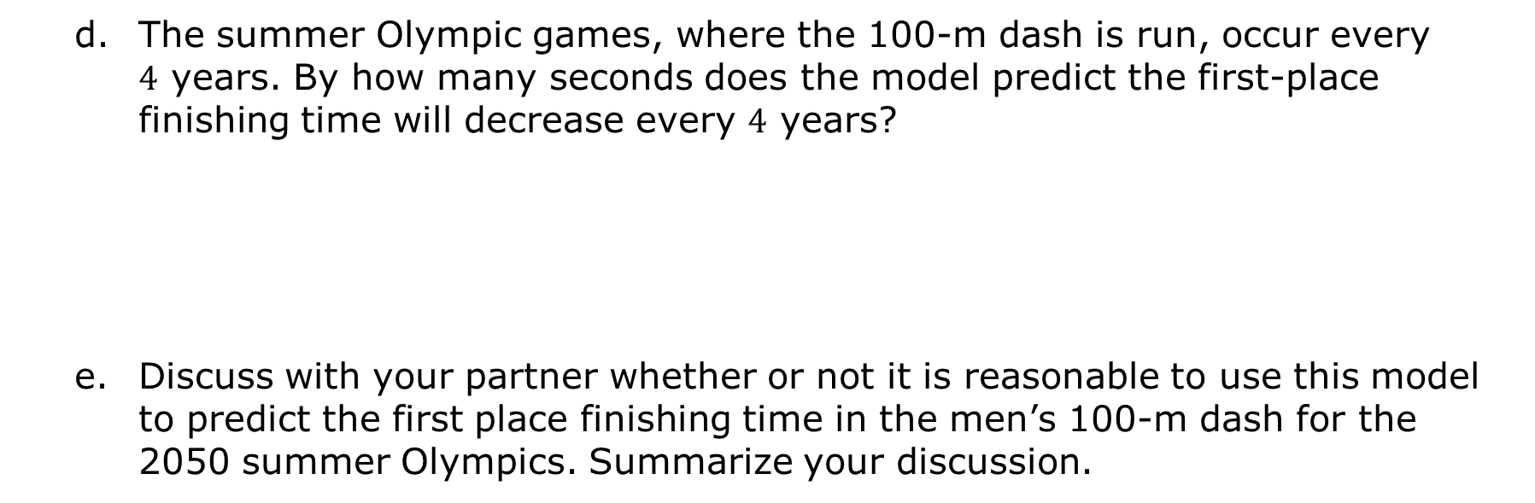
The summer Olympic games, where the 100-m dash is run, occur every $4$ years. By how many seconds does the model predict the first-place finishing time will decrease every $4$ years?
Discuss with your partner whether or not it is reasonable to use this model to predict the first place finishing time in the men’s 100-m dash for the 2050 summer Olympics. Summarize your discussion.
volume 1, pg. 149

Slide 24

Wrap-Up
volume 1, pg. 149

Slide 25
3.7.5 Wrap-Up: Growth Mindset
Mistakes are an opportunity to learn. Complete the statement to highlight a mistake you learned from.
My favorite mistake from today was ...
Means
I
Start
To
Acquire
Knowledge
Experience
Skills
volume 1, pg. 149

